Slide 1
Subject Name : COMPUTER ARCHITECTURE Presentation Title: BASIC COMPUTER INSTRUCTION
JEPPIAAR INSTITUTE OF TECHNOLOGY
“Self-Belief | Self Discipline | Self Respect”
Department of Computer Science and Engineering
Team Members:
Students Name Reg.No:
1.JULIE CHRISTINA.J 210618104021
2.GEETHANJALI.R 210618104013
3.KAVYA.M 210618104023
4.KAVIYA.O 210618104025
5.BIBILIN MANUELA.E 210618104009
6.KERTHIKA.K 210618104025

Slide 2
Objective
To Design/ Analyze/ Evaluate
An instruction format defines layout of bits of an instruction, in terms of its constituent parts.
An instruction format must include an opcode and implicitly or explicitly, zero or more operands.
Each explicit operand is referenced using one of addressing modes.

Slide 3
Technical Details
What are computer instructions?
Computer instructions are a set of machine language instructions that a particular processor understands and executes.

Slide 4
A computer performs tasks on the basis of the instruction provided.
An instruction comprises of groups called fields.

Slide 5
Technical Details
A basic computer has three instruction code formats which are:
Memory - reference instruction.
Register - reference instruction.
Input-Output instruction.

Slide 6
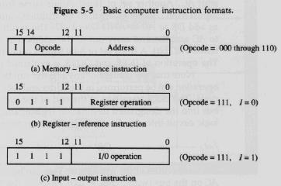
Block Diagram/ Work Flow/ Flow Chart

Slide 7
Technical Details
Memory reference instruction.
An instruction that has one or more of its operand addresses referring to a location in memory, as opposed to one of the CPU registers or some other way of specifying an operand.

Slide 8
Technical Details
Register reference instruction
A register reference instruction is generally any instruction that accesses registers for operands rather than memory. The format will vary depending on the specific architecture of the CPU.

Slide 9
Technical Details
Input/output instruction.
An instruction in a computer program that causes transfer of data between peripheral devices and main memory, and enables the central processing unit to control the peripheral devices connected to it.

Slide 10
Technical Details
Instruction format
Instruction format describes the internal structures (layout design) of the bits of an instruction, in terms of its constituent parts.
An Instruction format must include an opcode, and address is dependent on an availability of particular operands.

Slide 11
References
Birnie-Selwyn B, Guerin B. Teaching Children To Spell: Decreasing Consonant Cluster Errors By Eliminating Selective Stimulus Control. J Appl Behav Anal. 1997 Spring;30(1):69–91. [PMC free article] [Google Scholar]
De Rose J, De Souza DG, Hanna ES. Teaching reading and spelling: exclusion and stimulus equivalence. J Appl Behav Anal. 1996 Winter;29(4):451–469. [PMC free article] [PubMed] [Google Scholar]

Slide 12
THANK YOU

